Slide 1




CMR ENGINEERING COLLEGE
(UGC AUTONOMOUS)
(Accredited by NBA,Approved by AICTE NEW DELHI, Affiliated to JNTU, Hyderabad) Kandlakoya, Medchal Road, Hyderabad-501 401.
Department of Computer Science & Engineering MINI PROJECT ON
SECURE AND EFFICIENT DATA TRNSMISSION
FOR CLUSTER BASED WIRELESS SENSOR NETWORKS
Internal Guide:-
Mrs.Y.Prathima Assistant Professor,
Dept. of CSE.
By
P. Pravalika
P.Alfa
R.Venu
MD. Rahman Shareef
: (208R1A0547)
: (218R5A0546)
: (208R1A0548)
: (208R1A0552)
A.Y 2022-2023

Slide 2

ABSTRACT
To outsource encrypted data to the cloud server and processing queries on it remains a challenging task to support various queries on large set of data. Skyline queries are a popular methods for analyzing data in multi-criteria decision making scenarios. Encrypted data is often used to ensure data privacy, security and privacy concerns ,sensitive data need to be protected from the cloud server and unauthorized users.
This Photo by Unknown author is licensed under CC BY-NC-ND.

Slide 3
INTRODUCTION
Outsourcing data and computation to cloud server provides a cost-effective way to support large scale of data storage query processing.
Performing queries on encrypted data is difficult challenge, cloud server does not gain any knowledge on query and query result.
In the existing work, the system never used selected skyline queries with minimum attribute technique.
Proposed system provides a fully dominance protocol used as a building block for skyline queries.
It provides security guarantees by ensuring that the encrypted data is not exposed to unauthorized persons.
Data remains encrypted throughout the computation process, only final skyline query results are decrypted .

Slide 4
LITERATURE SURVEY
A Secure and Efficient Data Transmission Protocol for Cluster-Based Wireless Sensor Networks Using Secure Multi-Party Computation, by Muhammad Rizwan et al., published in the IEEE Transactions on Cloud Computing in 2021. This paper proposes a new secure and efficient data transmission protocol for cluster-based WSNs using secure multi-party computation (MPC). The protocol uses MPC to allow multiple cluster heads to collaborate in decrypting and processing the data without revealing their private keys to each other. The protocol is evaluated using simulations and real-world experiments, and the results show that it outperforms existing schemes in terms of security, efficiency, and scalability.
A Secure and Efficient Data Transmission Scheme for Cluster-Based Wireless Sensor Networks Using Blockchain, by Muhammad Sajjad et al., published in the IEEE Transactions on Information Forensics and Security in 2022. This paper proposes a new secure and efficient data transmission scheme for cluster-based WSNs using blockchain. The scheme uses blockchain to provide data integrity and authenticity, and it uses a lightweight encryption algorithm to protect the data. The protocol is evaluated using simulations and real-world experiments, and the results show that it outperforms existing schemes in terms of security, efficiency, and scalability.

Slide 5

EXISTING METHODOLOGY
One approach is to use homomorphic encryption ,But this method is computationally expensive and not scalable for large datasets.
Another method is to use secure multi-party computation, but this approach is also computationally expensive and requires a large amount of communication overhead between parties.
DISADVANTAGES:
It never used selected skyline queries with minimum attribute sum which provides more security on data.
System is slow in data processing ,it does not implement optimization of data partitioning.
This Photo by Unknown author is licensed under CC BY-SA.

Slide 6
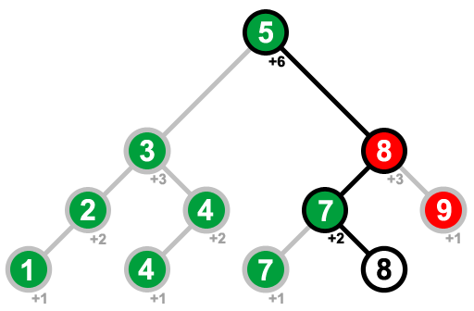
PROPOSED METHODOLGY
PROJECT SCOPE :
Using a combination of homomorphic encryption and binary search tree data structures.
Homomorphic encryption is to encrypt the data and perform comparisons between encrypted value.
Binary search tree data structure to efficiently compute skyline queries on the encrypted data.
OBJECTIVE:
It reduces the computational and communication overhead compared to existing methods, data remain encrypted throughout the entire computation process, only the final skyline queries results are decrypted.

Slide 7

SOFTWARE REQUIREMENT SPECIFICATIONS
Operating System - Windows 10/11
Coding Language - Java/J2EE(JSP, Servlet)
Front End - J2EE
Back End - MySQL
This Photo by Unknown author is licensed under CC BY.

Slide 8

HARDWARE REQUIREMENTS
Processor - intel core i9
RAM - 4 GB (min)
Hard Disk - 120 GB
Key Board
Mouse
Monitor

Slide 9
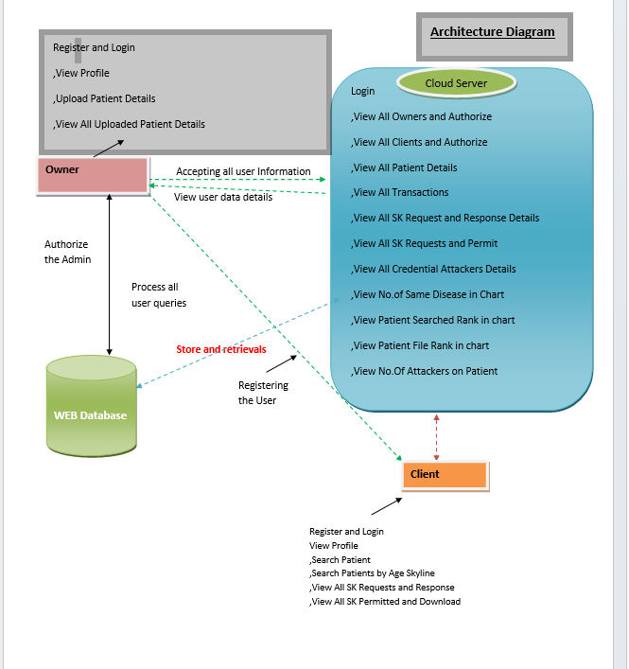
ARCHITECTURE:

Slide 10
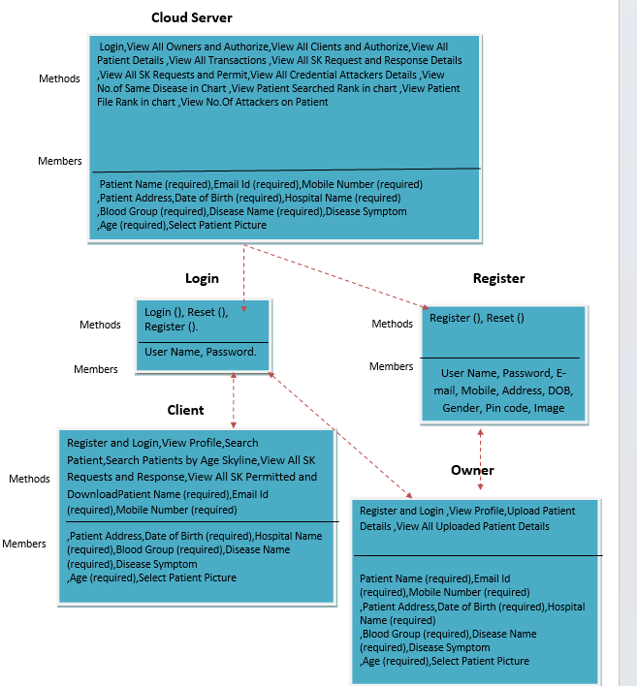
Class Diagram

Slide 11
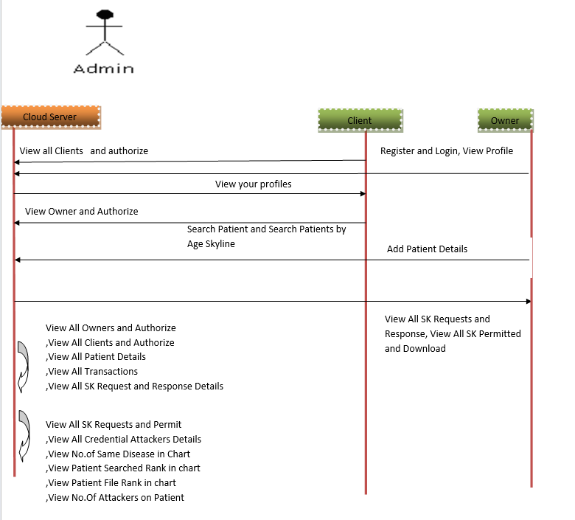
Sequence Diagram

Slide 12
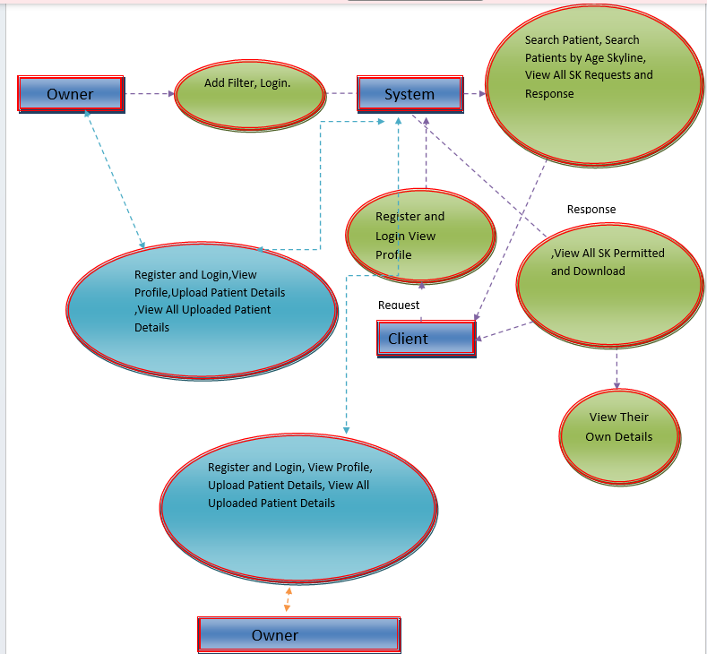
Data Flow Diagram

Slide 13
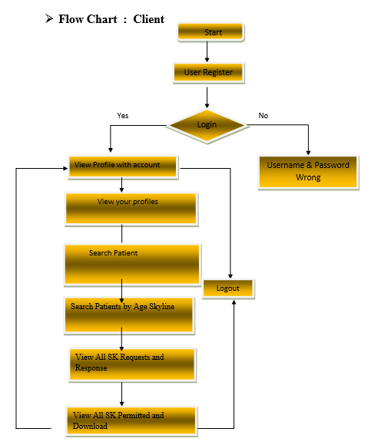
Client Flowchart

Slide 14
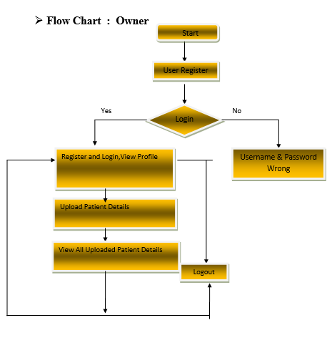
Owner Flowchart

Slide 15
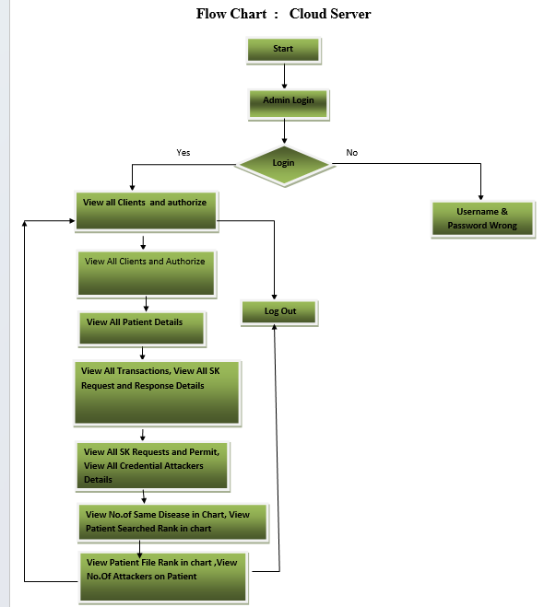
Cloud Flowchart

Slide 16
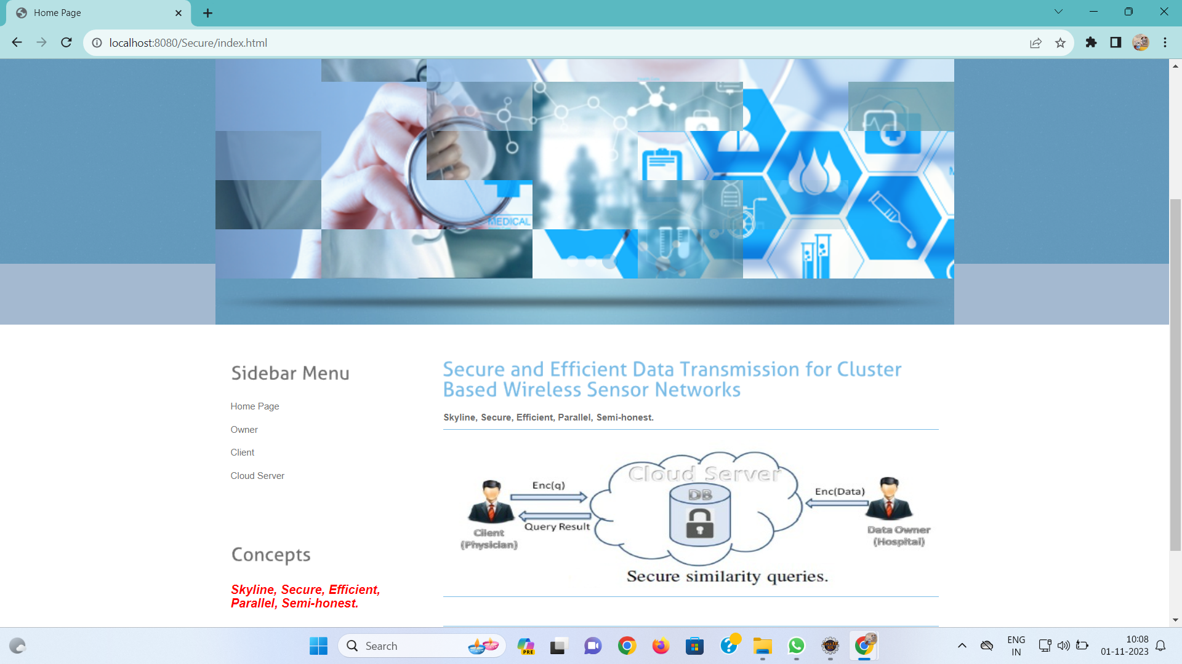
Screen Shots Of Output Screen login:link

Slide 17
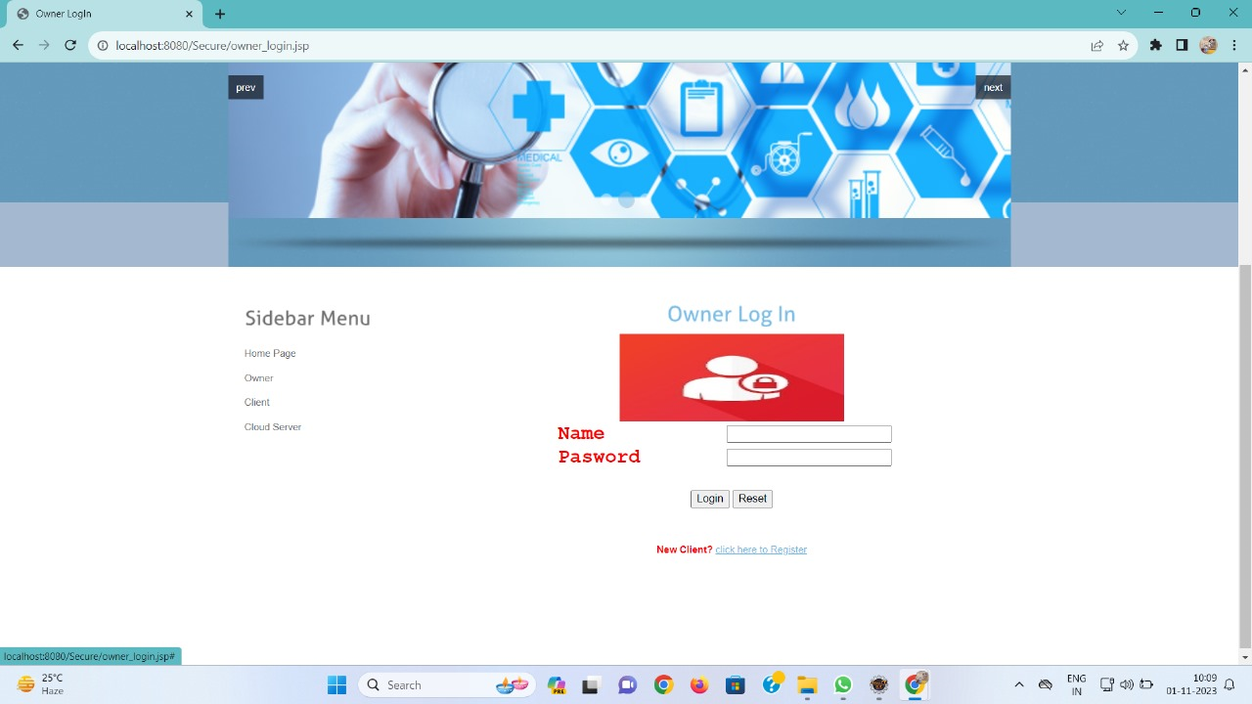
Owner login

Slide 18
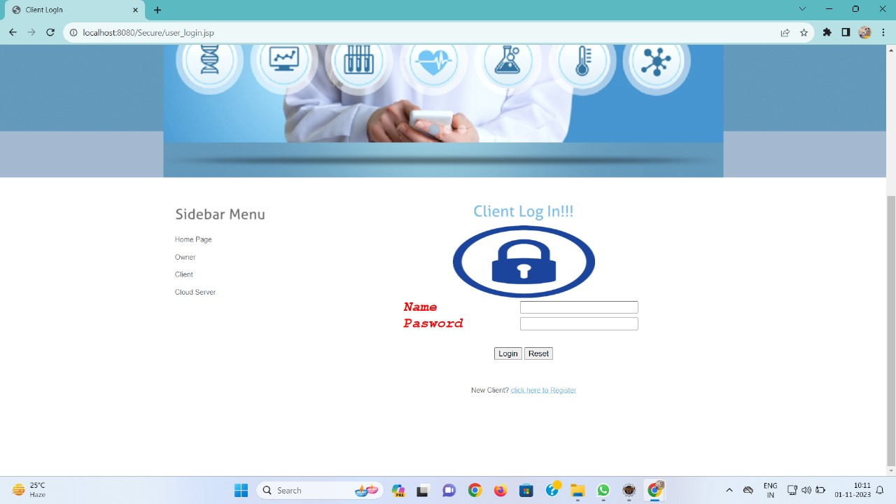
Client Login

Slide 19
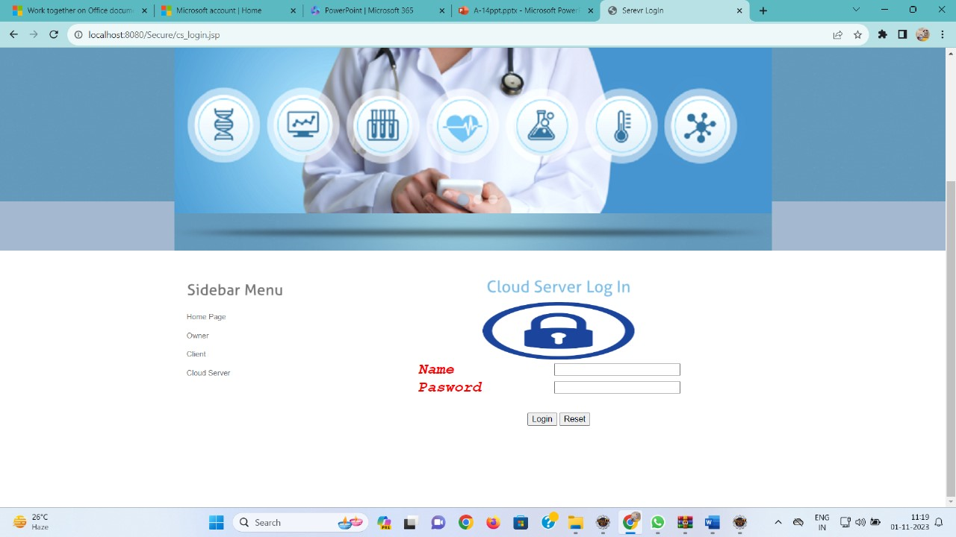
Cloud Login

Slide 20

Cloud Server Menu

Slide 21
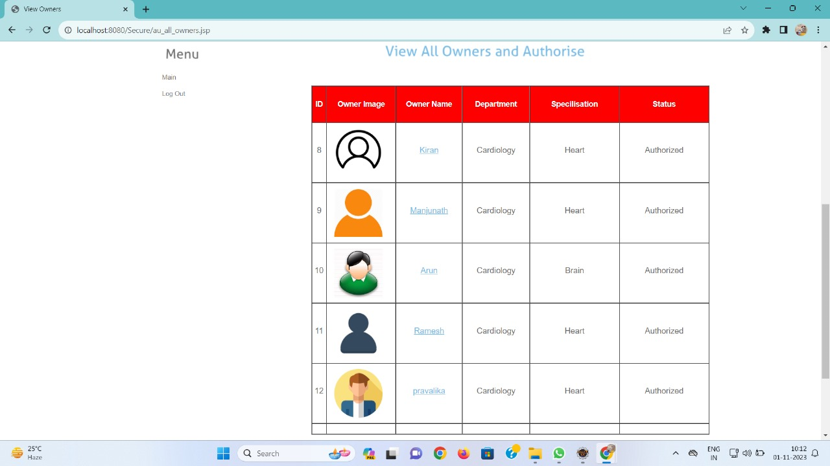
Owner Details

Slide 22
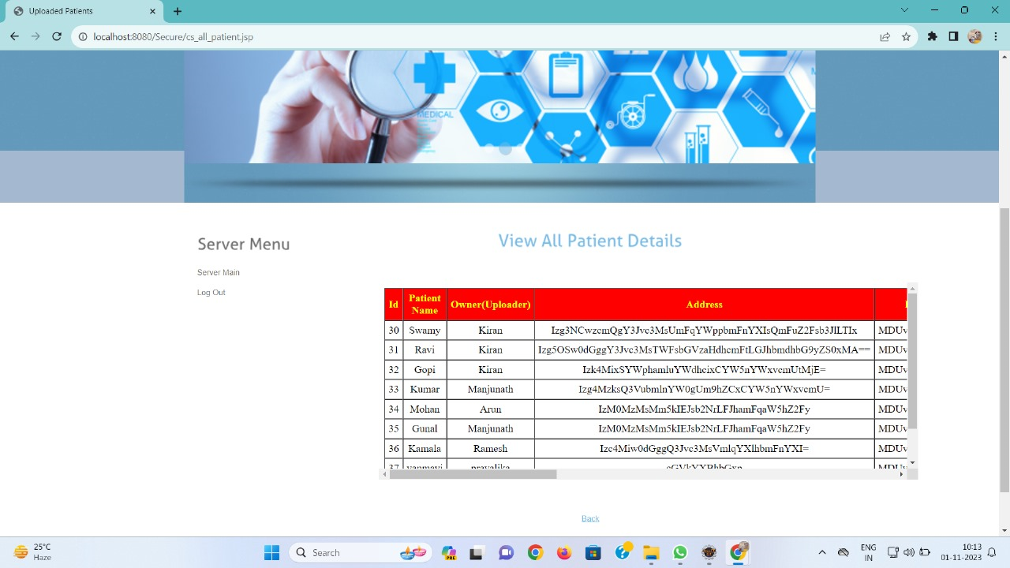
Patient Details

Slide 23

Queries on trained data

Slide 24
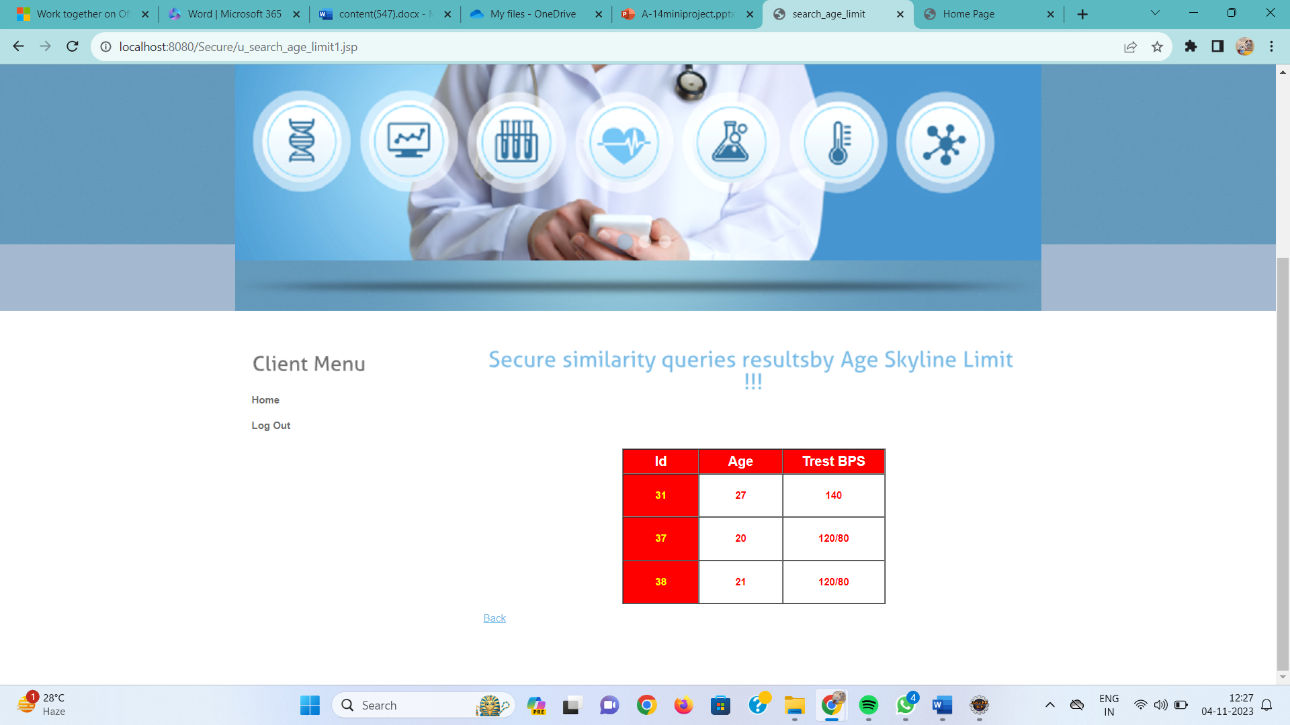
Result from query processing

Slide 25
Testing Techniques
Unit Testing : During this testing, each module is tested individually and the module interfaces are verified for the consistency with design specification. All important processing path are tested for the expected results. All error handling paths are also tested.
Integration Testing : Integration testing addresses the issues associated with the dual problems of verification and program construction. The bottom up approaches tests each module individually and then each module is module is integrated with a main module and tested for functionality.
User Acceptance Testing : User Acceptance of a system is the key factor for the success of any system. The system under consideration is tested for user acceptance by constantly keeping in touch with the prospective system users at the time of developing and making changes wherever required. The system developed provides a friendly user interface that can easily be understood even by a person who is new to the system.
Output Testing : After performing the validation testing, the next step is output testing of the proposed system, since no system could be useful if it does not produce the required output in the specified format. Asking the users about the format required by them tests the outputs generated or displayed by the system under consideration. Hence the output format is considered in 2 ways – one is on screen and another in printed format.
Validation Testing : Validation checks are performed on the following fields.
Text Field
Numeric Field

Slide 26
Future Enhancement
Semantically Secure Encryption: The system uses semantically secure encryption to ensure that data remains confidential even when processed in the cloud server.
Secure Dominance Protocol: Introduces a new secure dominance protocol that can be used as a building block for not only skyline queries but also for other types of queries, enhancing the overall security of the system.
Privacy and Security: The system places a strong emphasis on data privacy and security, ensuring that sensitive data remains protected from unauthorized access, especially in the context of cloud-based data storage and processing.
Multi-Criteria Decision Making: The system supports skyline queries, which are essential for multi-criteria decision-making processes. It helps identify the best records that meet multiple criteria, even when the relative weights of attributes are not predefined.
Optimization of Data Partitioning: Implements data partitioning optimization to enhance the speed of data processing, addressing one of the limitations of the existing system.

Slide 27
Conclusion
We proposed a fully secure skyline protocol on encrypted data using two non-colliding cloud servers under the semi-honest model. It ensures semantic security in that the cloud servers know nothing about the data including indirect data patterns, query, as well as the query result. In addition, the client and data owner do not need to participate in the computation. We also presented a secure dominance protocol which can be used by skyline queries as well as other queries. Furthermore, we demonstrated two optimizations, data partitioning and lazy merging, to further reduce the computation load. Finally, we presented our implementation of the protocol and demonstrated the feasibility and efficiency of the solution. As for future work, we plan to optimize the communication time complexity to further improve the performance of the protocol.

Slide 28
REFERENCES:
T. Hara, V.I. Zadorozhny, and E. Buchmann, Wireless Sensor Network Technologies for the Information Explosion Era, Studies in Computational Intelligence, vol. 278. Springer-Verlag, 2010.
Y. Wang, G. Attebury, and B. Ramamurthy, “A Survey of Security Issues in Wireless Sensor Networks,” IEEE Comm. Surveys & Tutorials, vol. 8, no. 2, pp. 2-23, Second Quarter 2006.
K. Pradeepa, W.R. Anne, and S. Duraisamy, “Design and Implementation Issues of Clustering in Wireless Sensor Networks,” Int’l J. Computer Applications, vol. 47, no. 11, pp. 23-28, 2012

Slide 29
THANK YOU A-14

